Slide 1
Unveiling Implicit Positional Encoding Circuit in Causal Transformer

Slide 2
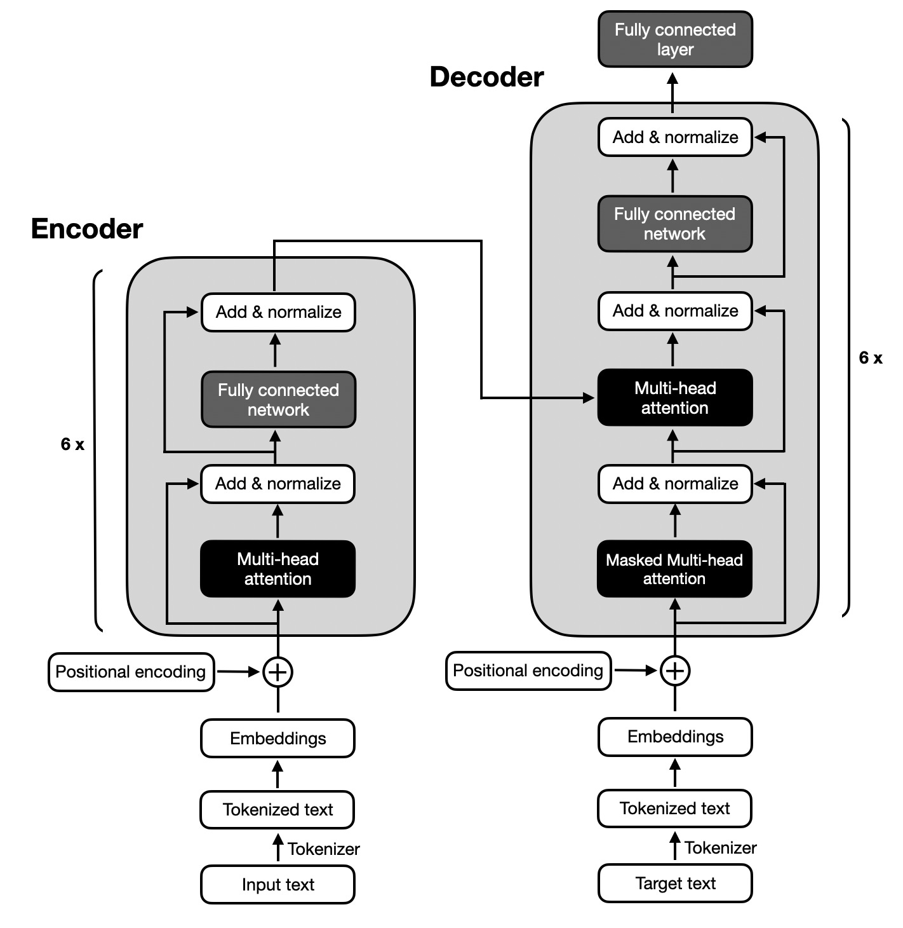
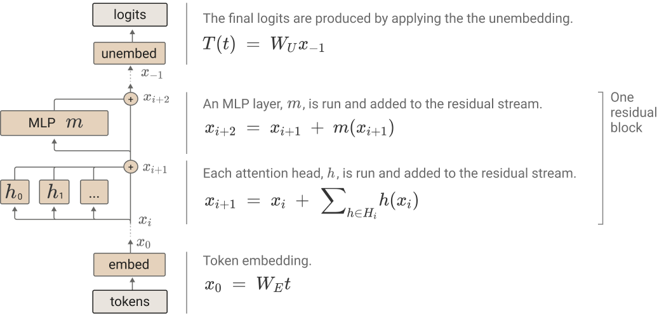

Intro – Encoder vs Decoder
Encoder – Can access the entire input at each attention operation
Decoder – Directional, hence, at timestamp $t$ can access only the $t$ leftmost tokens.
Decoder

Slide 3
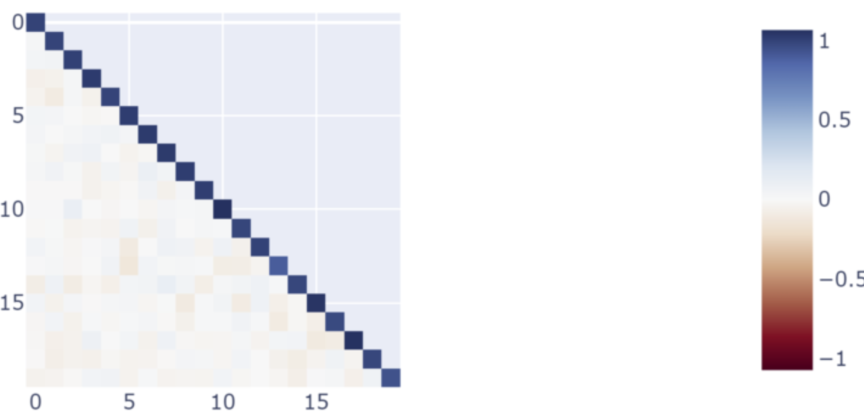
Initialization matters – almost orthogonal vectors + Inductive Bias of causal transformer
W/O the need to learn anything, if we initializae the X@W_Q and X@W_K from Normal(0, 0.1).
Then X@W_K @ X@W_Q:

Slide 4
Initialization matters – almost orthogonal vectors + Inductive Bias of causal transformer
The values on the diagonal are just slightly higher than the values on the lower triangle, and they both greater that the values on the upper triangle. Applying a softmax on this attention scores column-wise would induce the following attention pattern:

Slide 5
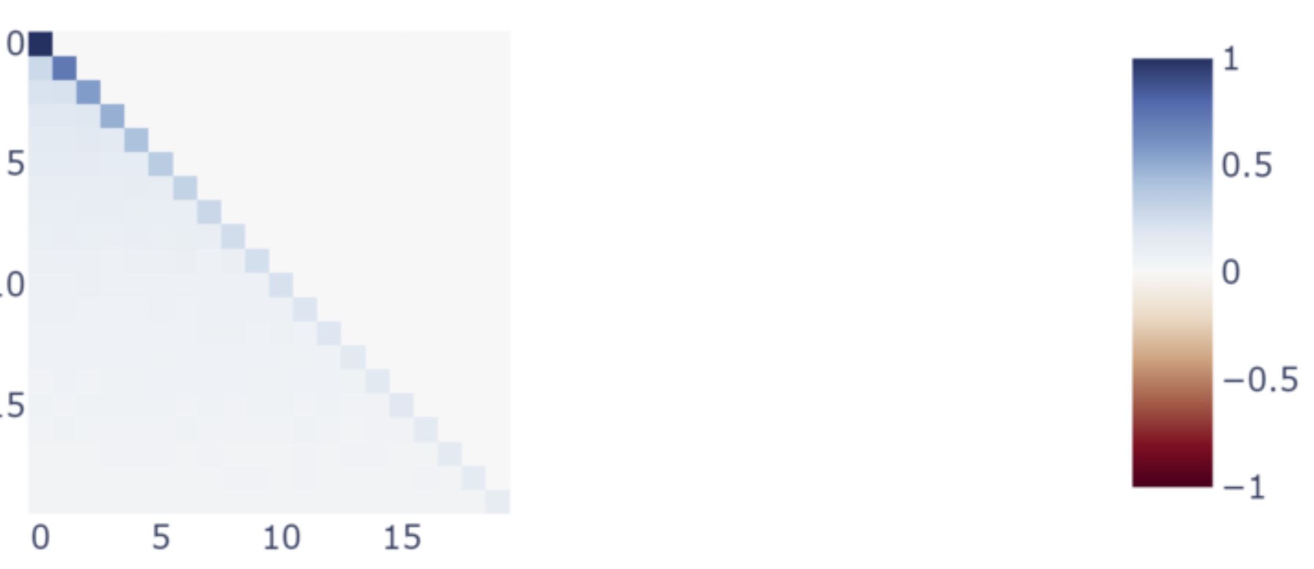
Initialization matters – almost orthogonal vectors + Inductive Bias of causal transformer
Calculating the Variance of each position (row) would result in a monotonically decreasing variance.

Slide 6
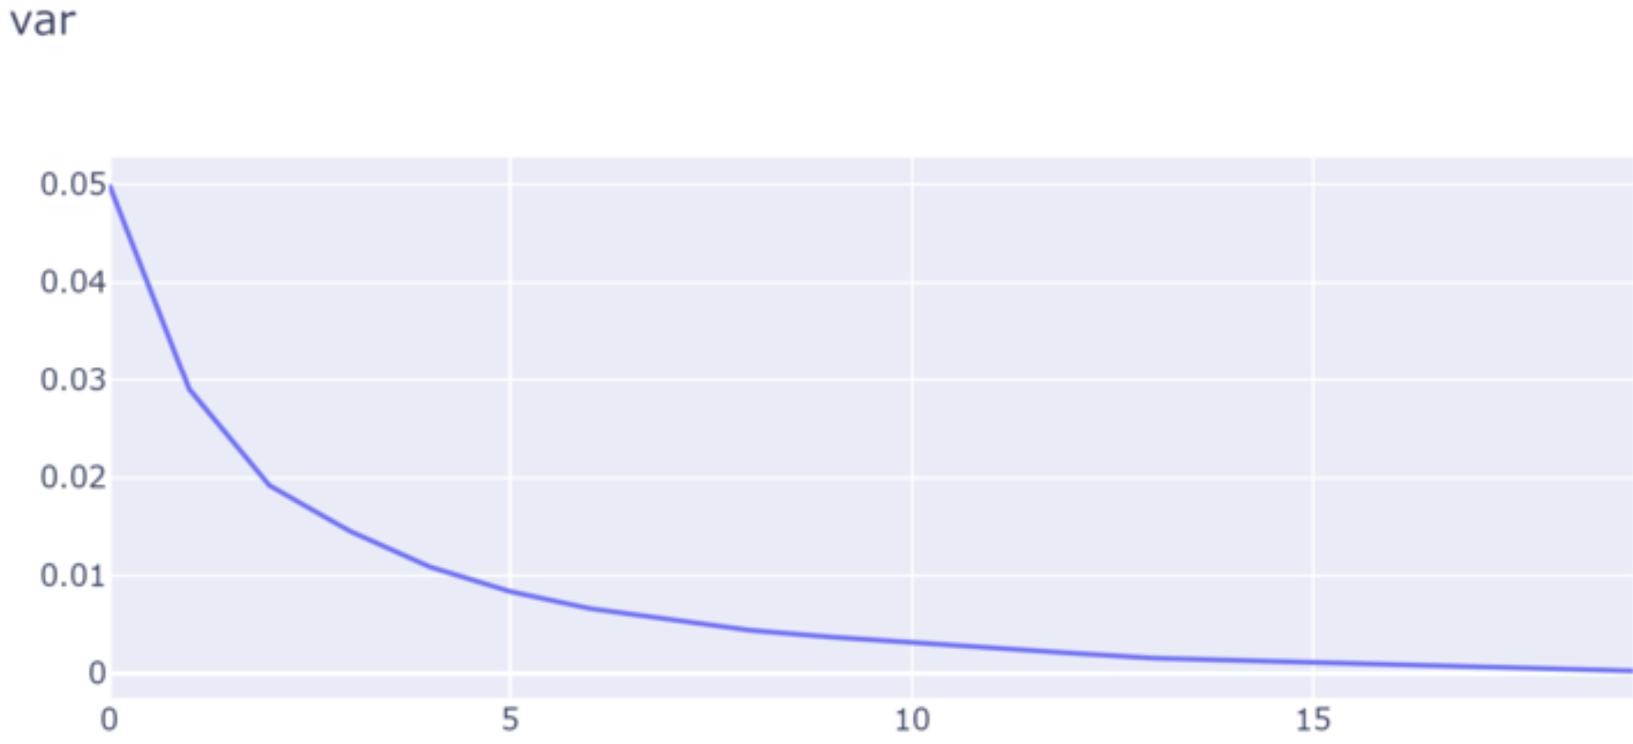
Initialization matters – almost orthogonal vectors + Inductive Bias of causal transformer
Calculating the Variance of each position (row) would result in a monotonically decreasing variance.

Slide 7
Initialization matters – almost orthogonal vectors + Inductive Bias of causal transformer - constraints
a_i * a_i = c1, a_i * a_j = c2, c1>c2>0 (works for the other direction).
Not allowed: c1>>c2
Exp(c1) = Exp(Large number) >>> Exp(Something which is almost 0 per channel, aggregated over channels to be a small number) = Exp(2)
If c1>>c2 then after softmax the diagonal is 1, every i,j,i!=j is 0. And the variance as a function of positions is a const function.

Slide 8
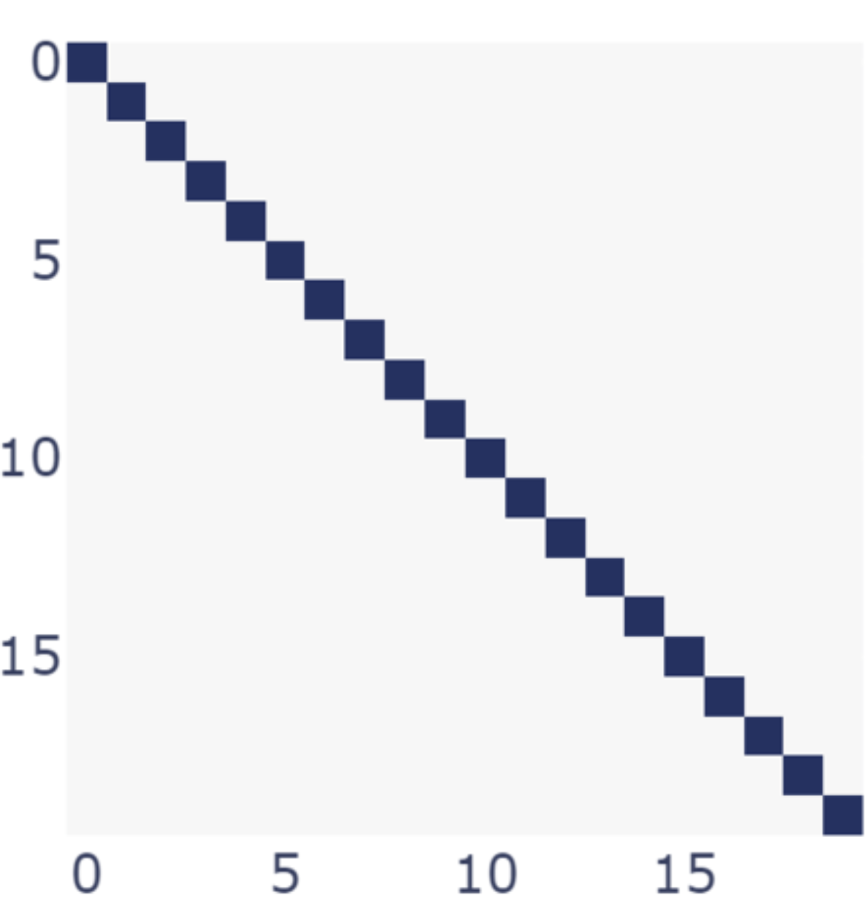
Initialization matters – almost orthogonal vectors + Inductive Bias of causal transformer – Phase change
Mean=0, Std>0.1
Can’t encode position

Slide 9
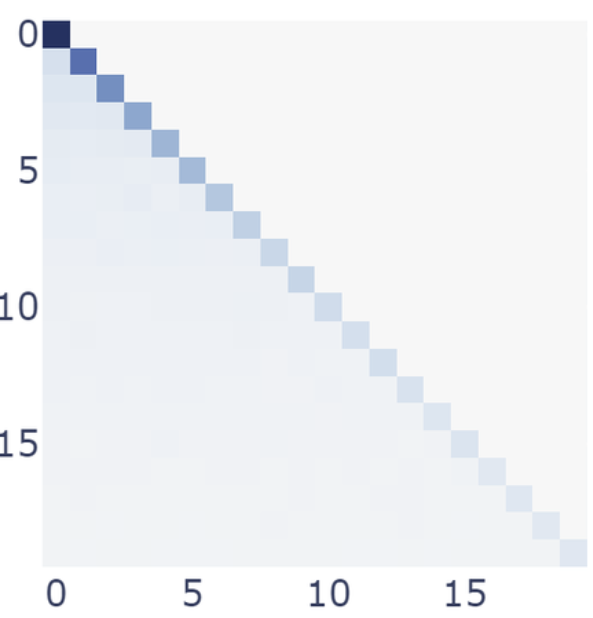
Initialization matters – almost orthogonal vectors + Inductive Bias of causal transformer – Phase change
Mean=0, 0.1>Std>0.01
Encode position at the variance, and a nice property is that the diagonal is also monotonic.

Slide 10
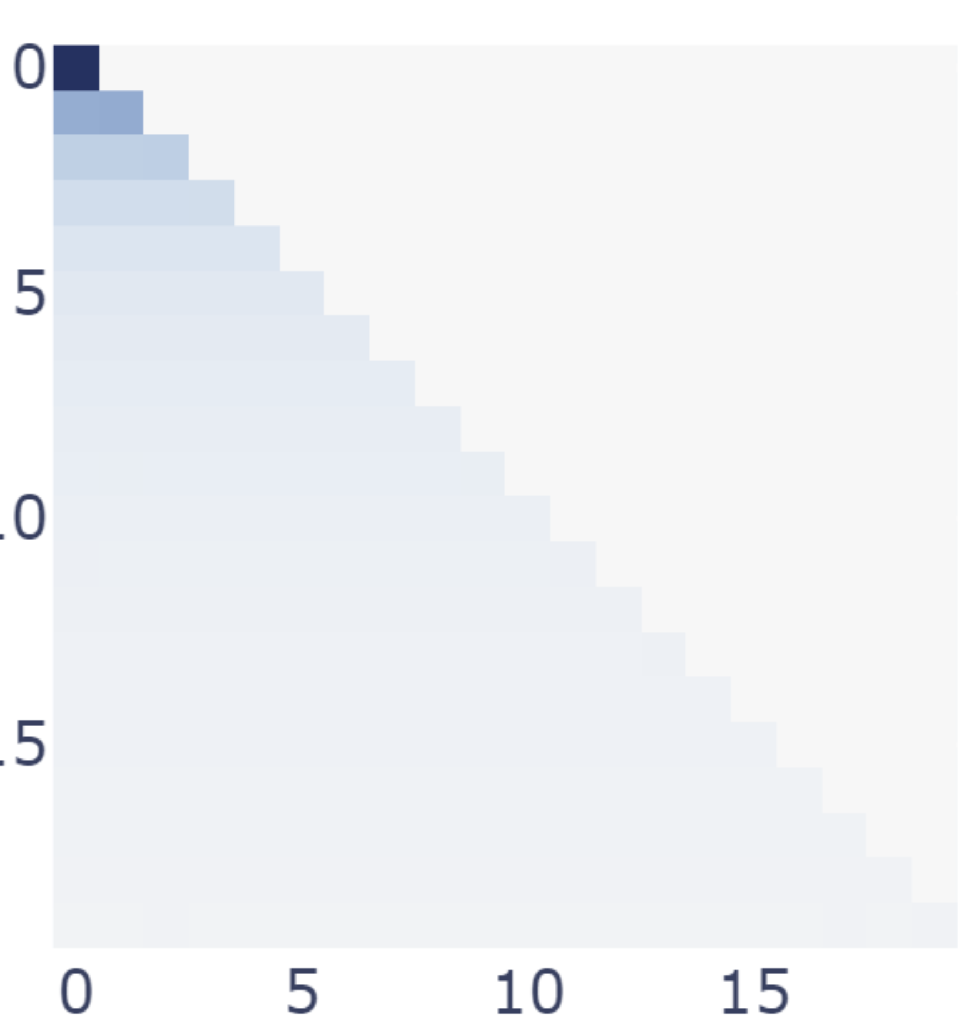
Initialization matters – almost orthogonal vectors + Inductive Bias of causal transformer – Phase change
Mean=0, 0.01>Std
Can encode position.

Slide 11
Conclusions till now
Initializing “almost orthogonal vectors” is part of the circuit. – mean and variance are part of the circuit.
Softmax is part of the circuit.
The form of causal attention is part of the circuit (The change in the amount of 0s at the upper triangle enables the monotonicity in the variance.).

Slide 12
LayerNormalization is part of the circuit

Slide 13
Explanation
Intuition – std -> channel/neuron
Explain the math

Slide 14
0.75 Don’t train embeddings
The point is to prove that training even w/o training the embeddings can recover positional information implicitly.
Because in the real world we train the network w/ the embeddings, we do have another exp in which we train also the embeddings and show it is not hurts.

Slide 15
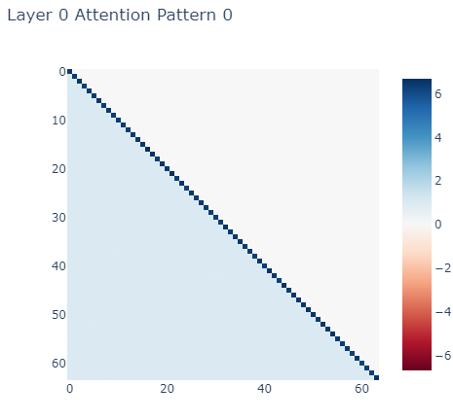
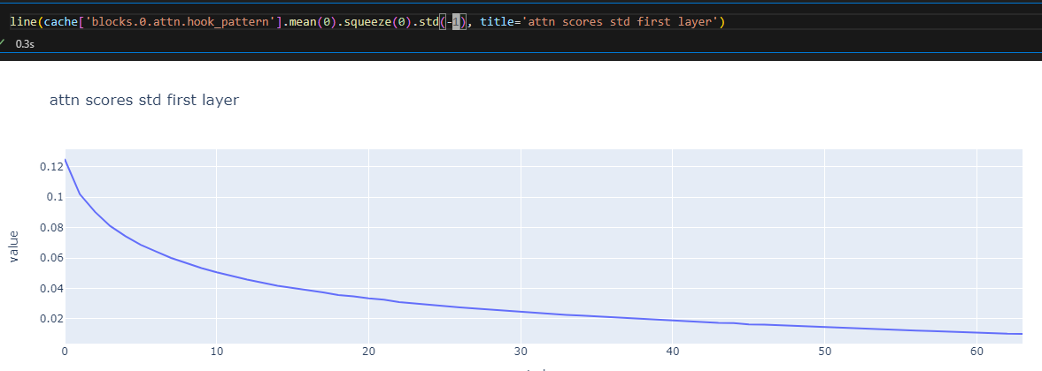
0.75 Don’t train embeddings

Slide 16
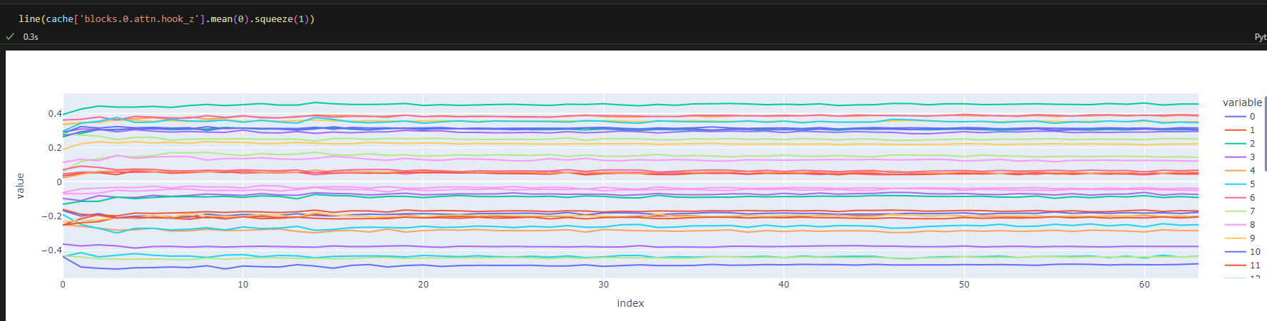
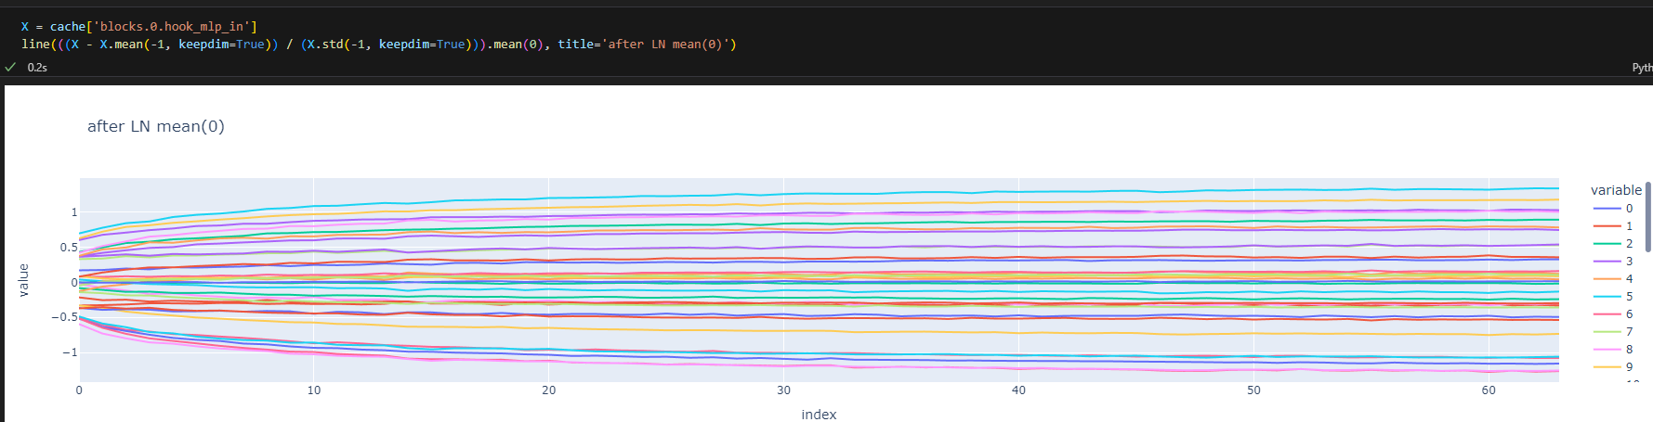
0.75 Don’t train embeddings

Slide 17
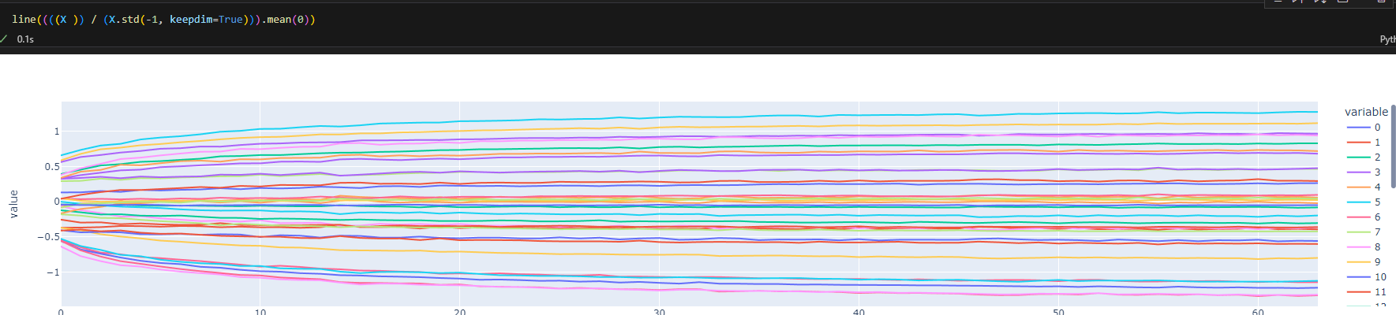
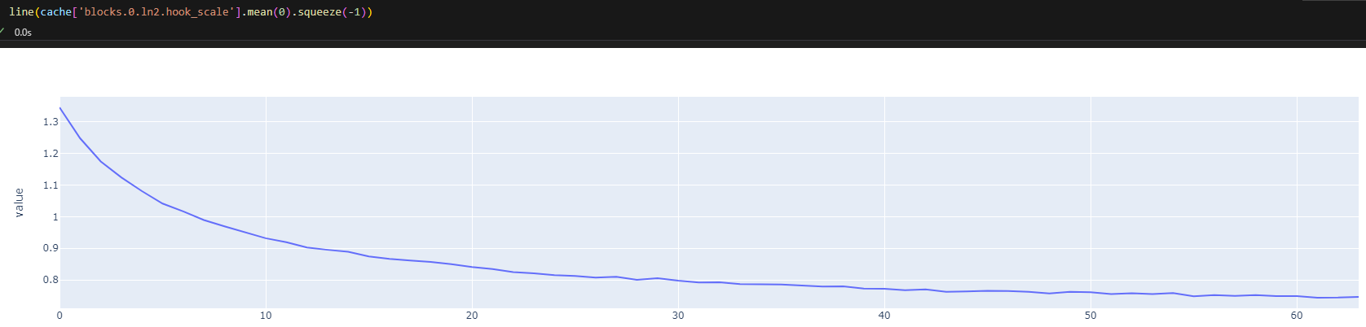
0.75 Don’t train embeddings

Slide 18
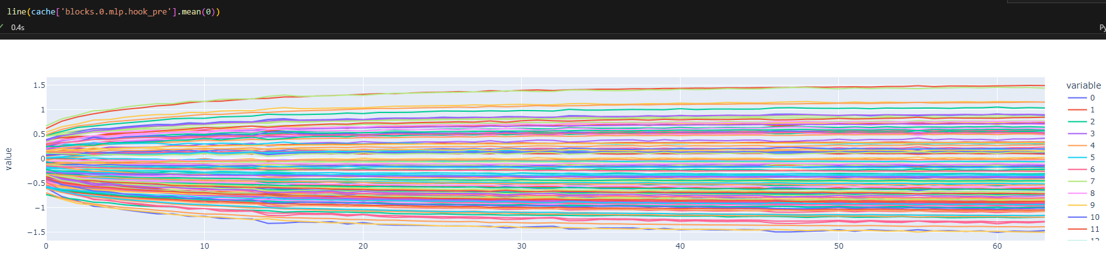
0.75 Don’t train embeddings

Slide 19
Experiment 1
Given a vector of 64 tokens selected *w* replacement (token can appears more than only once) predict the absolute position regardless on anything.

Slide 20
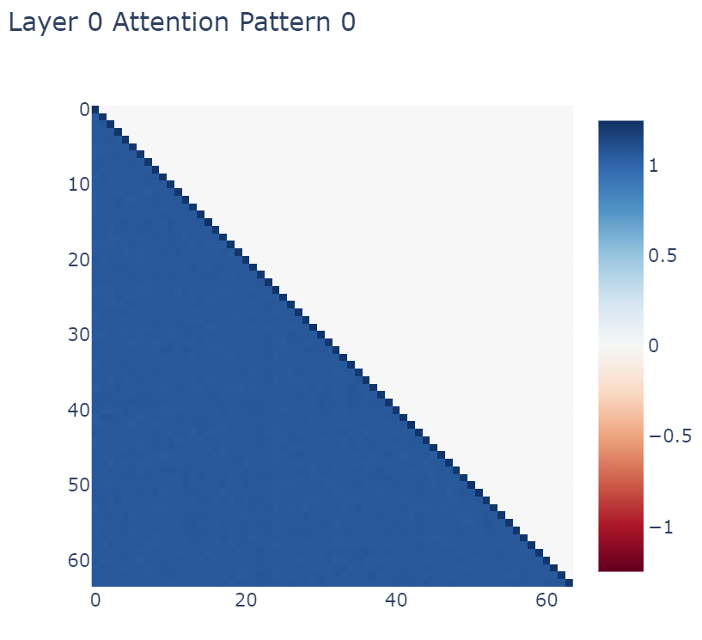
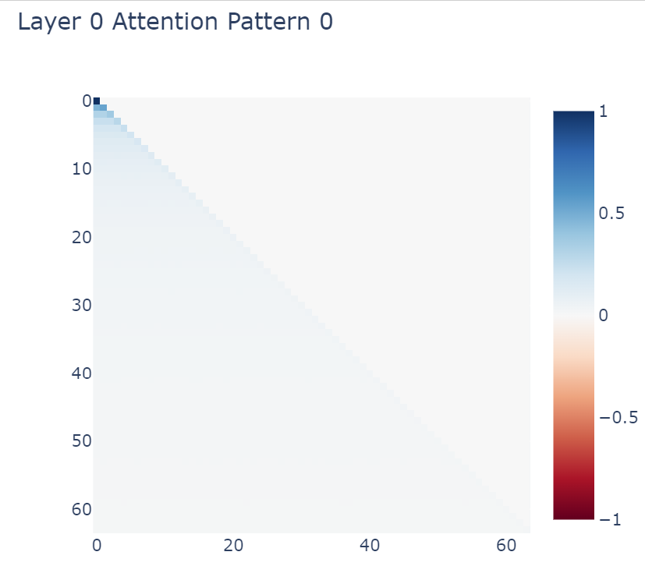
First Layer attn pattern – synthetic DS

Slide 21
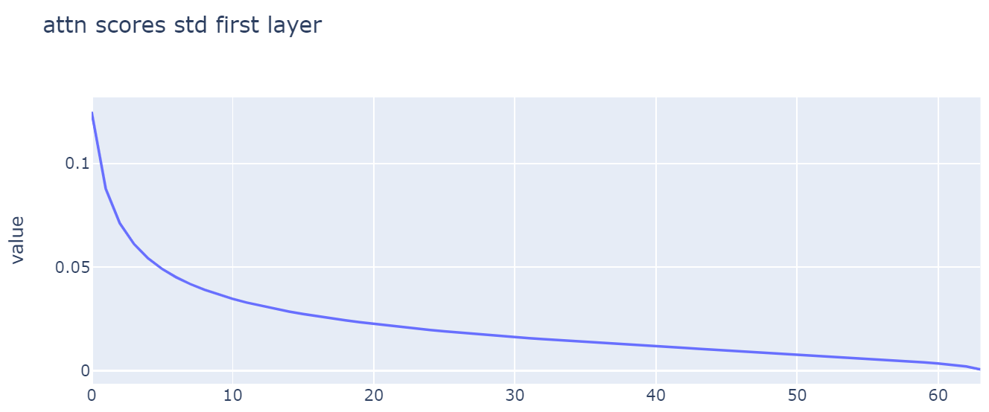
STD over poses

Slide 22
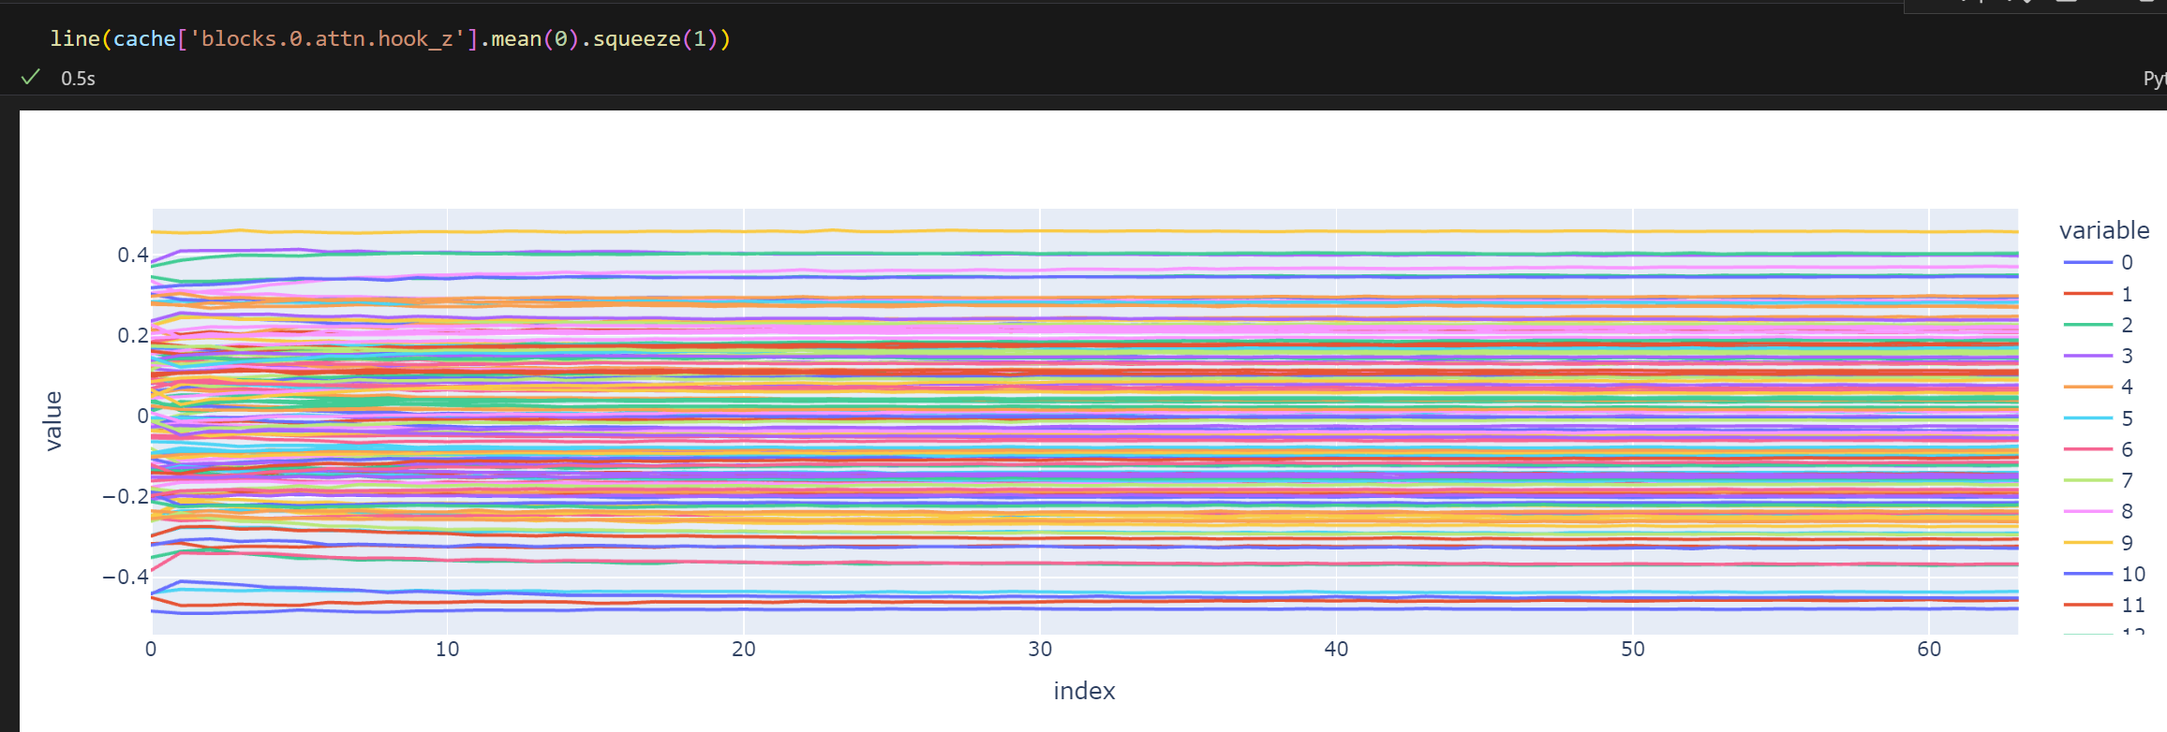
Weighted attn output mean over poses

Slide 23
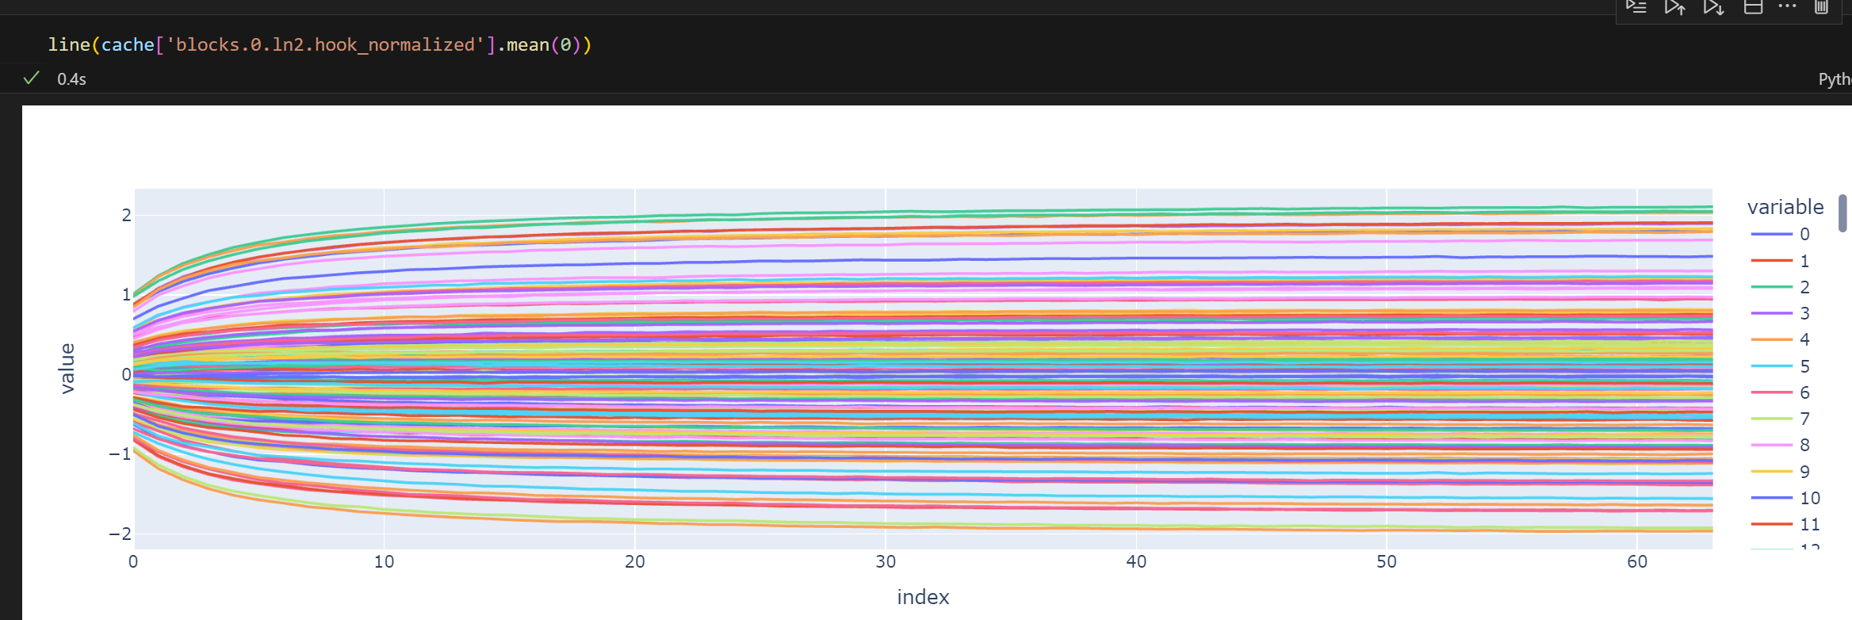
Right after LN, the position is encoded in the MLP’s input columns – From std rows to columns explicilty

Slide 24
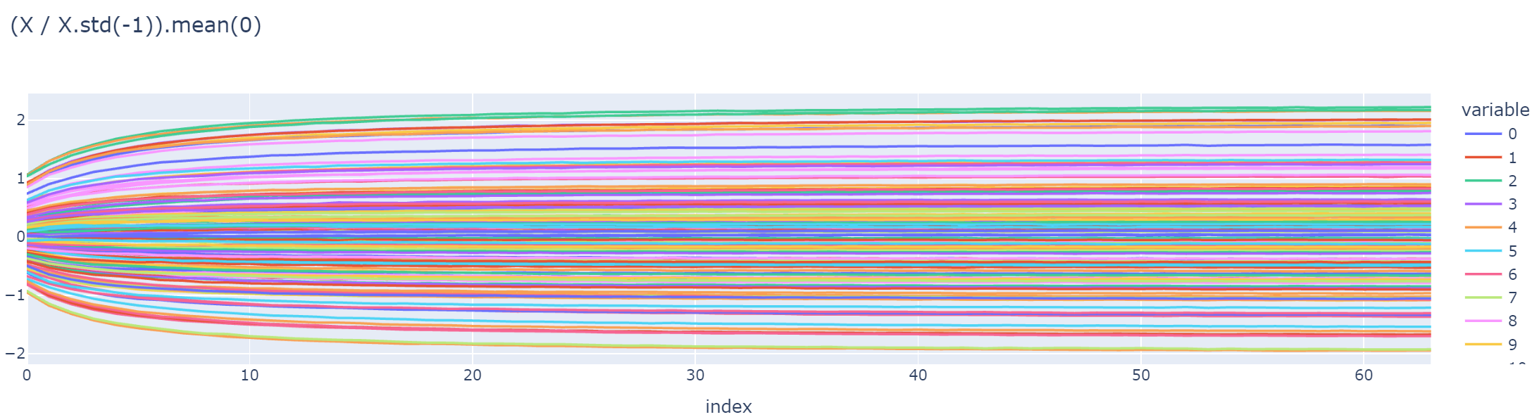
The component within the LN which responsible for the explicit writing of the positional information to the columns of the MLP input

Slide 25
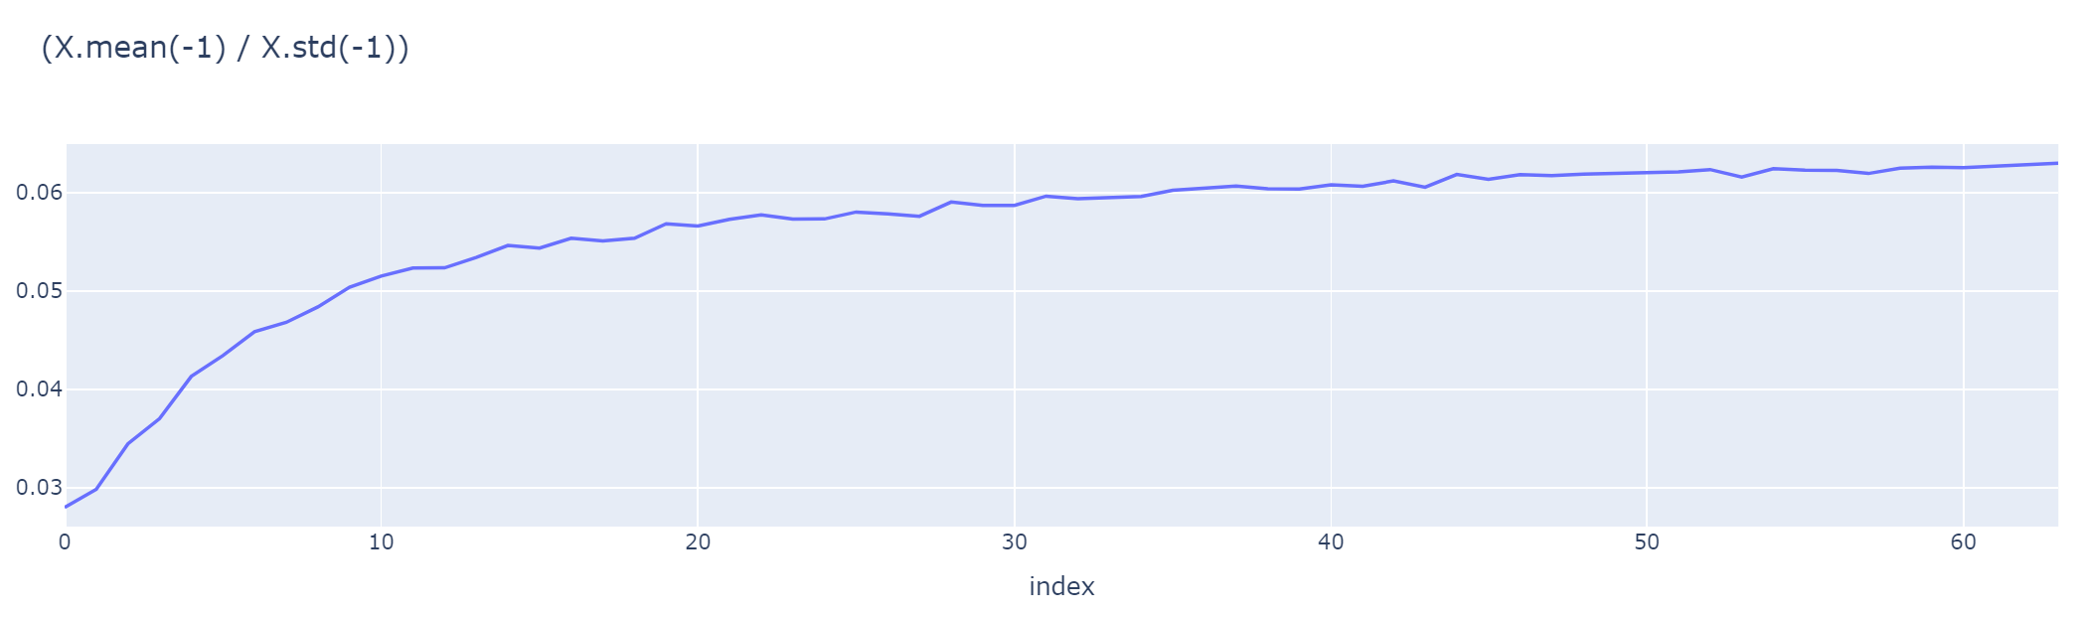
The other component also has a monotonic form which we substitute by

Slide 26
1.5 Run without LN

Slide 27
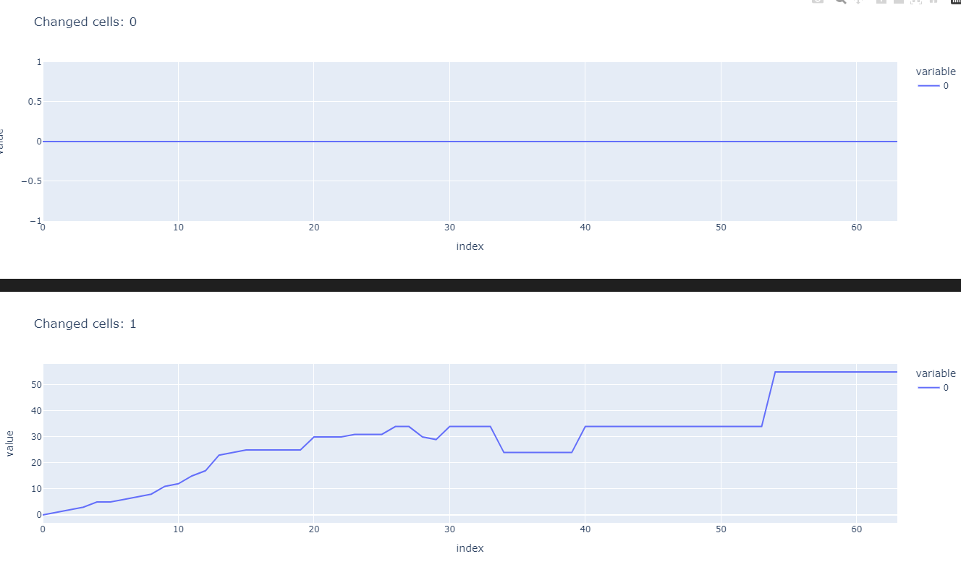
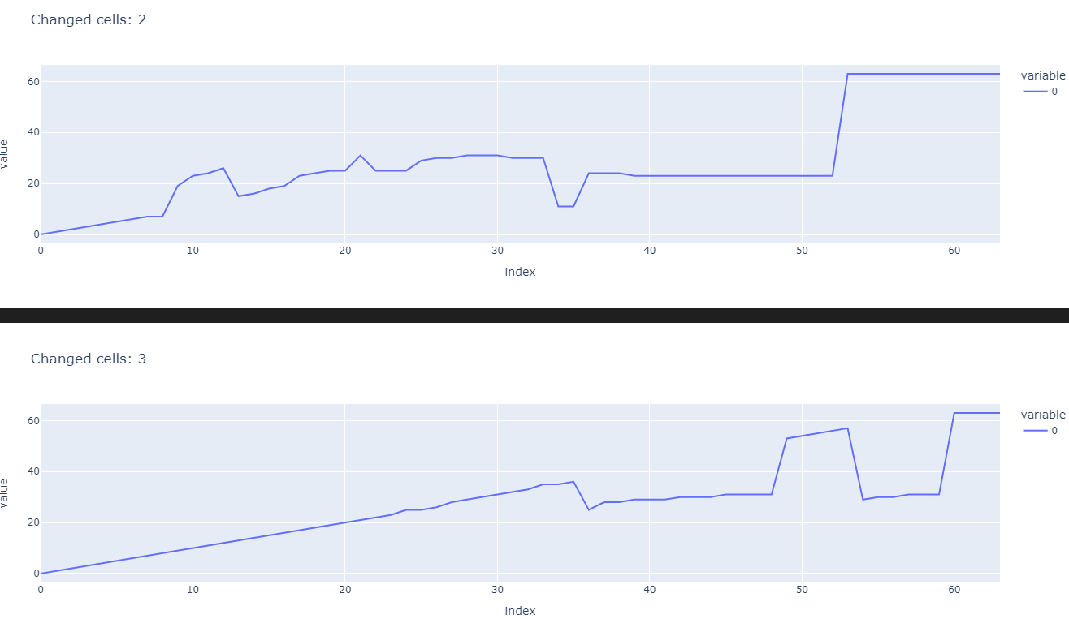
Experiment 2
The circuit weakness is the number of distinct tokens.

Slide 28
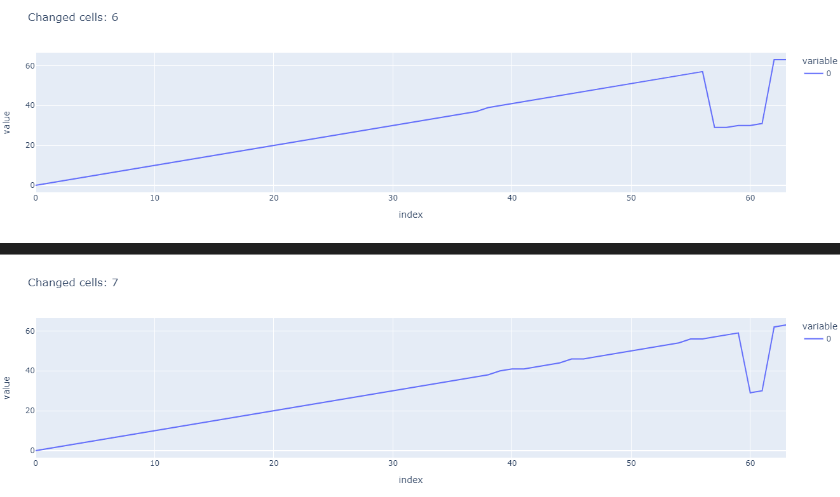
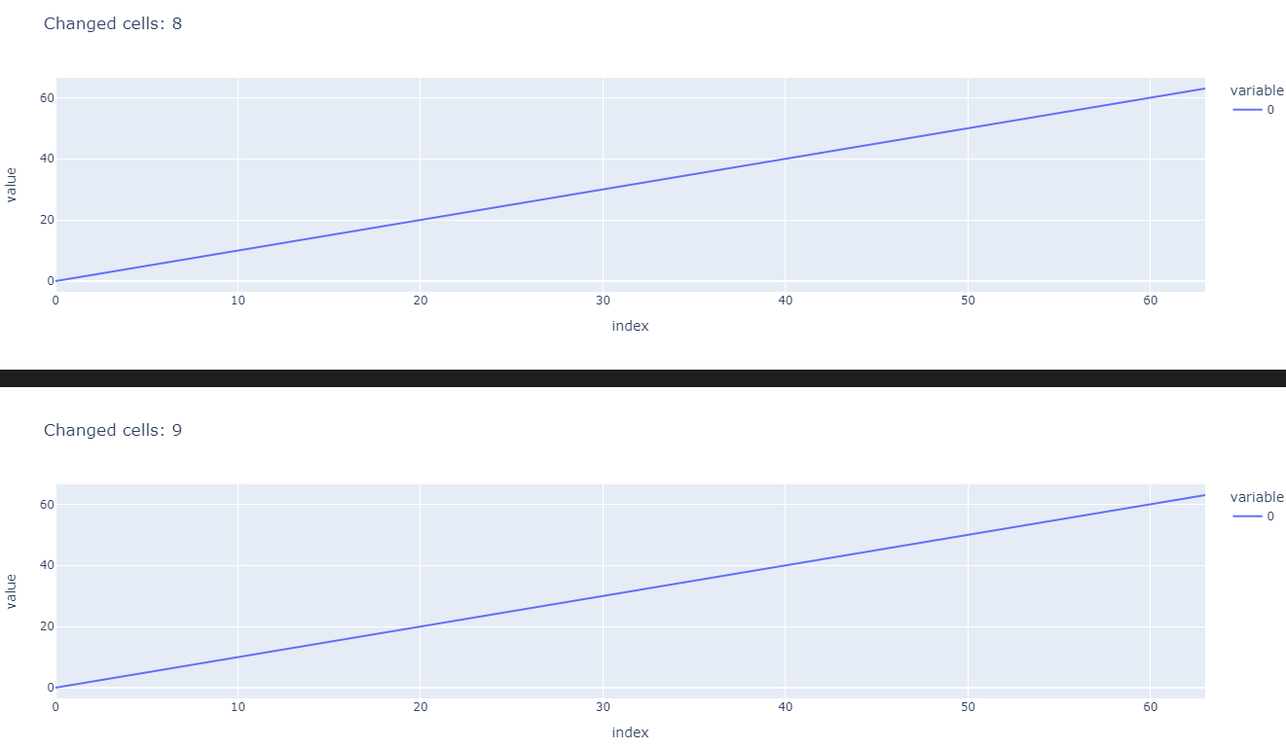
Experiment 2
The circuit weakness is the number of distinct tokens.

Slide 29
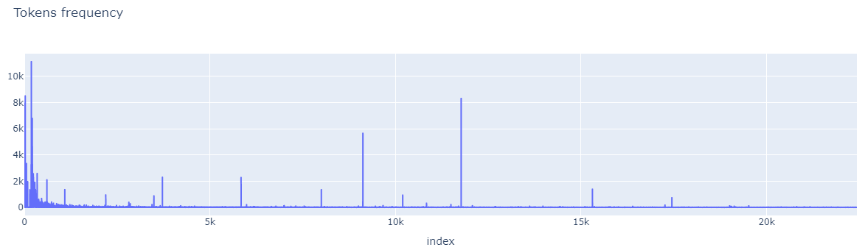
Experiment 3 – Natural Language

Slide 30
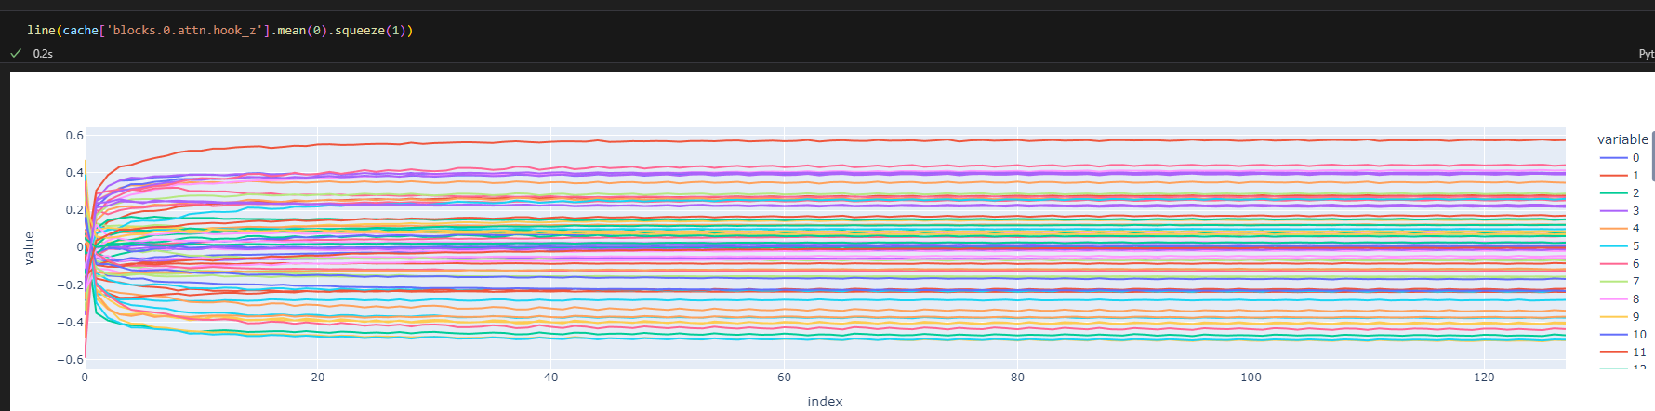

Slide 31
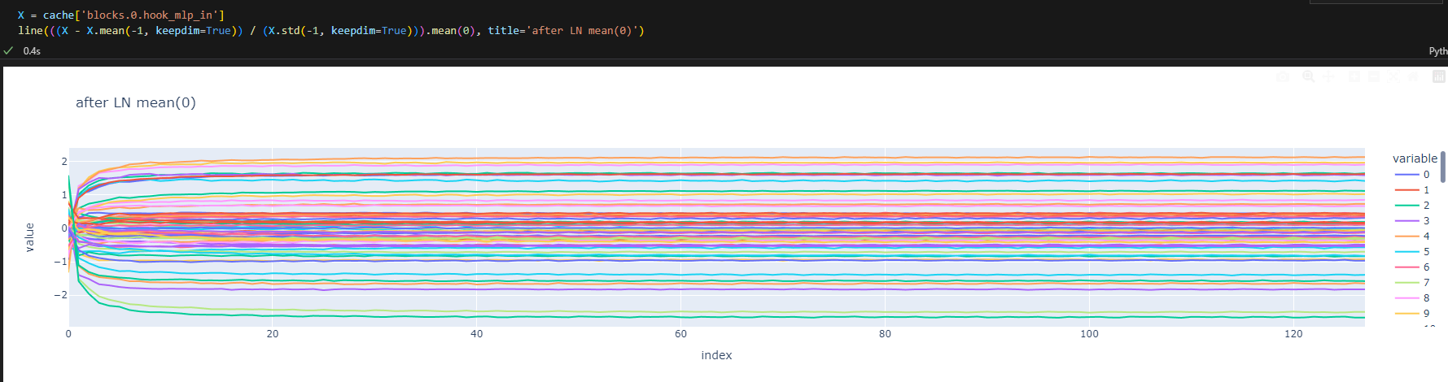
After LN

Slide 32
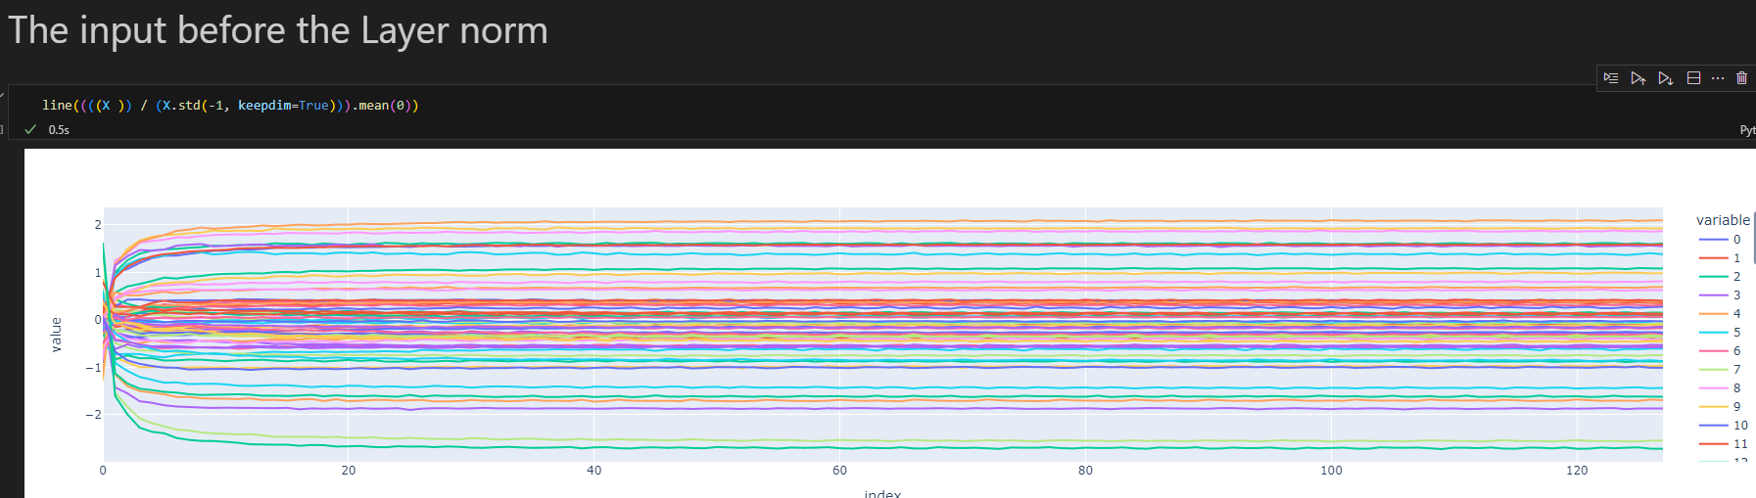

Slide 33
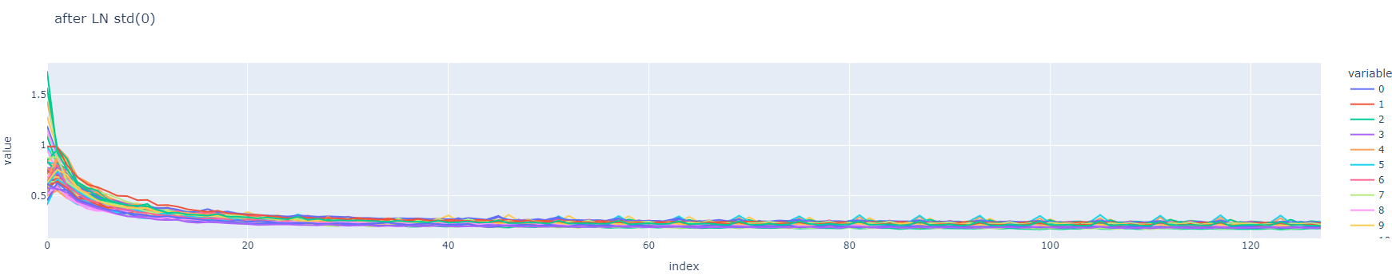

Slide 34
4 – Causal intervention

Slide 35
5 – Train/find LM w/o positional information

Slide 36
Todos
What are the contributions?
Introduction – A story in bullets
There is a phenomena of encoding positional information even w/o position encoding
Transformers usually train w/ position embedding…
People argue the LN omit positional information we argue it helps.
Learn more about Xavier initialization.
Background – Circuits, things we can leanrt w/ causal transformer but can't with MLM.

